Slide 1
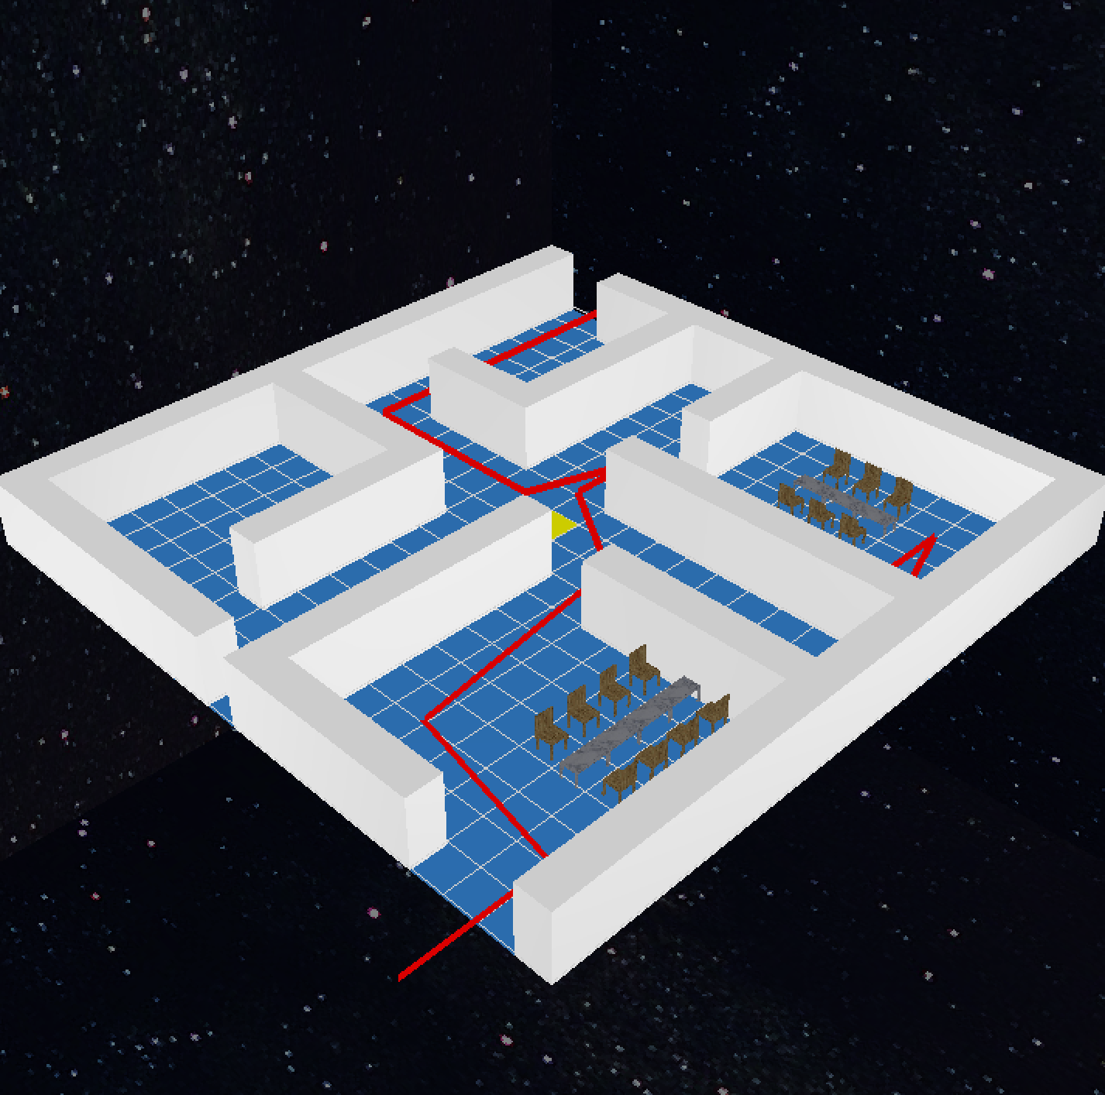
Emergency Plan Simulator
20121420 jongyun lee
20101011 hyeongmin Kang

Slide 2
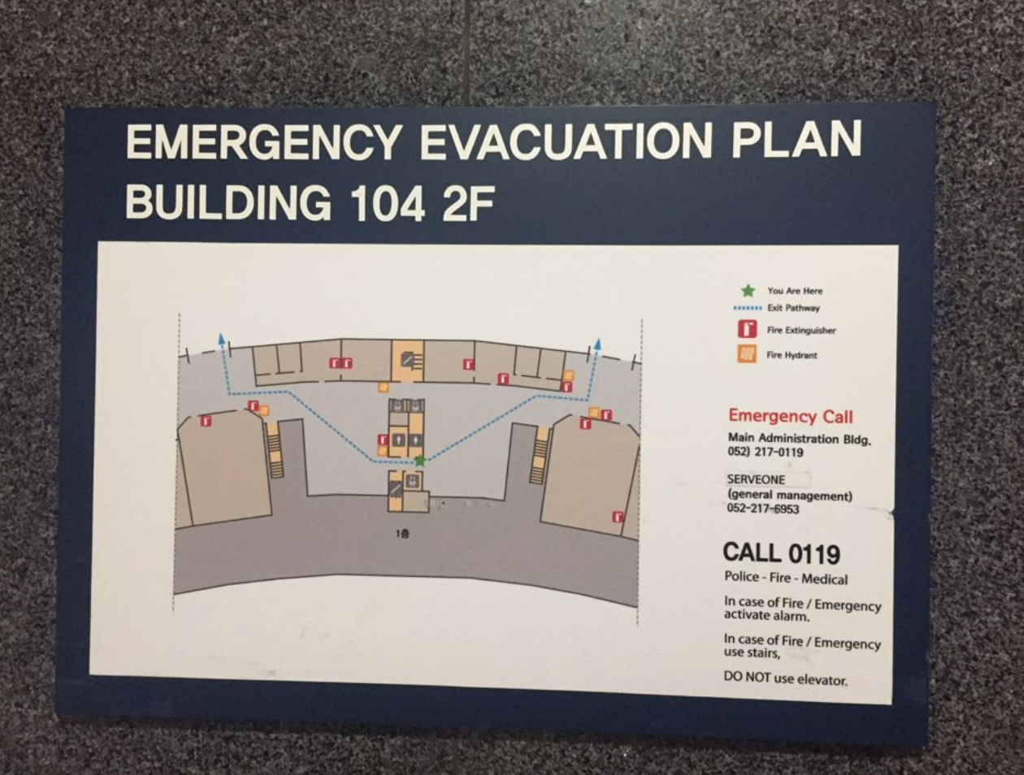
Intro

Slide 3
Let’s Start!!

Slide 4

Functions 1 : Grid
Draw X, Y lines (20 x 20)
Cursor highlight

Slide 5
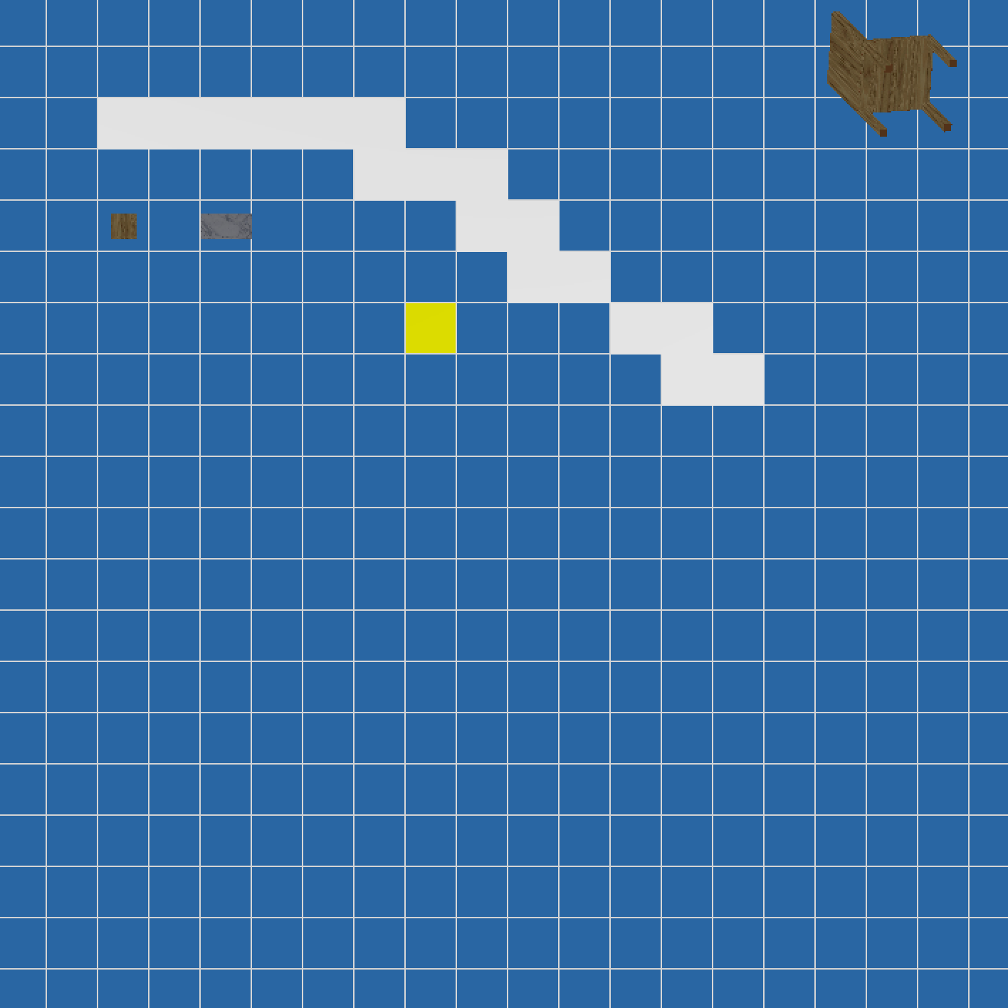
Functions 2 : Object
Chair / Table / Wall
Phong shading
Texture mapping
Mark Objects on
20 X 20 Map Matrix
Current Selected Object
Rotating Animation

Slide 6
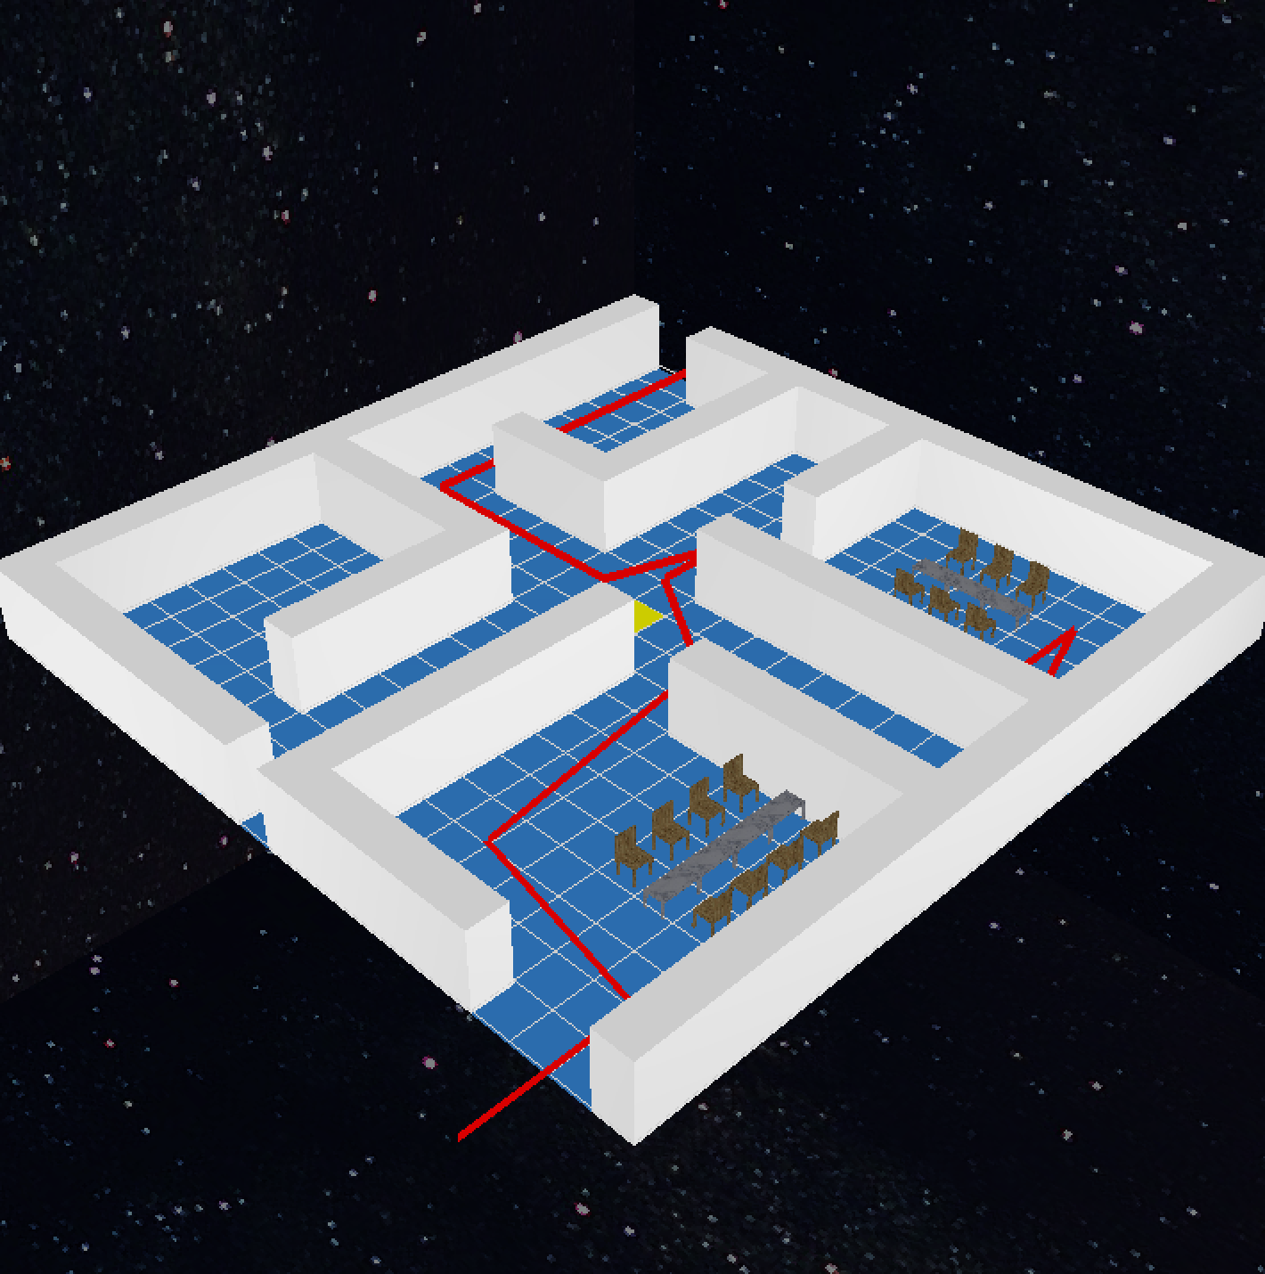
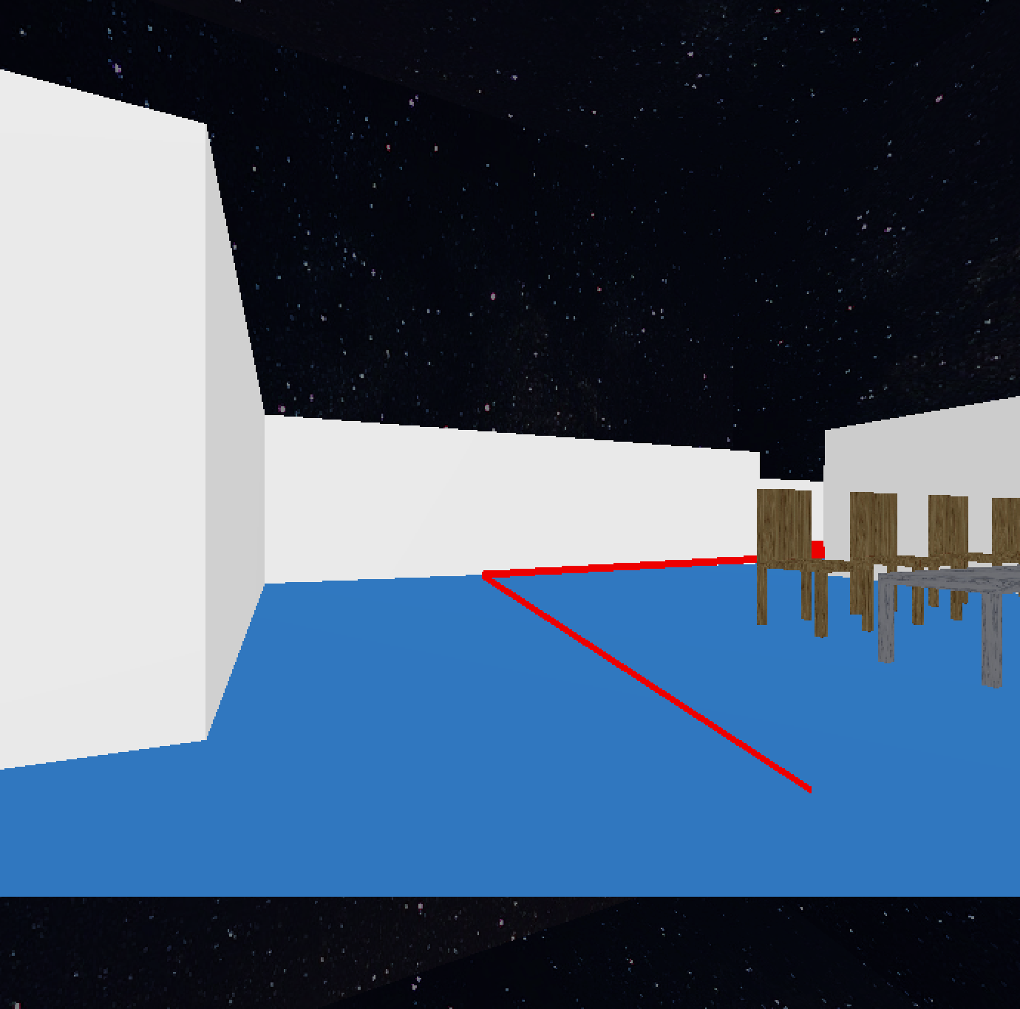
Functions 3 : Perspective

Slide 7
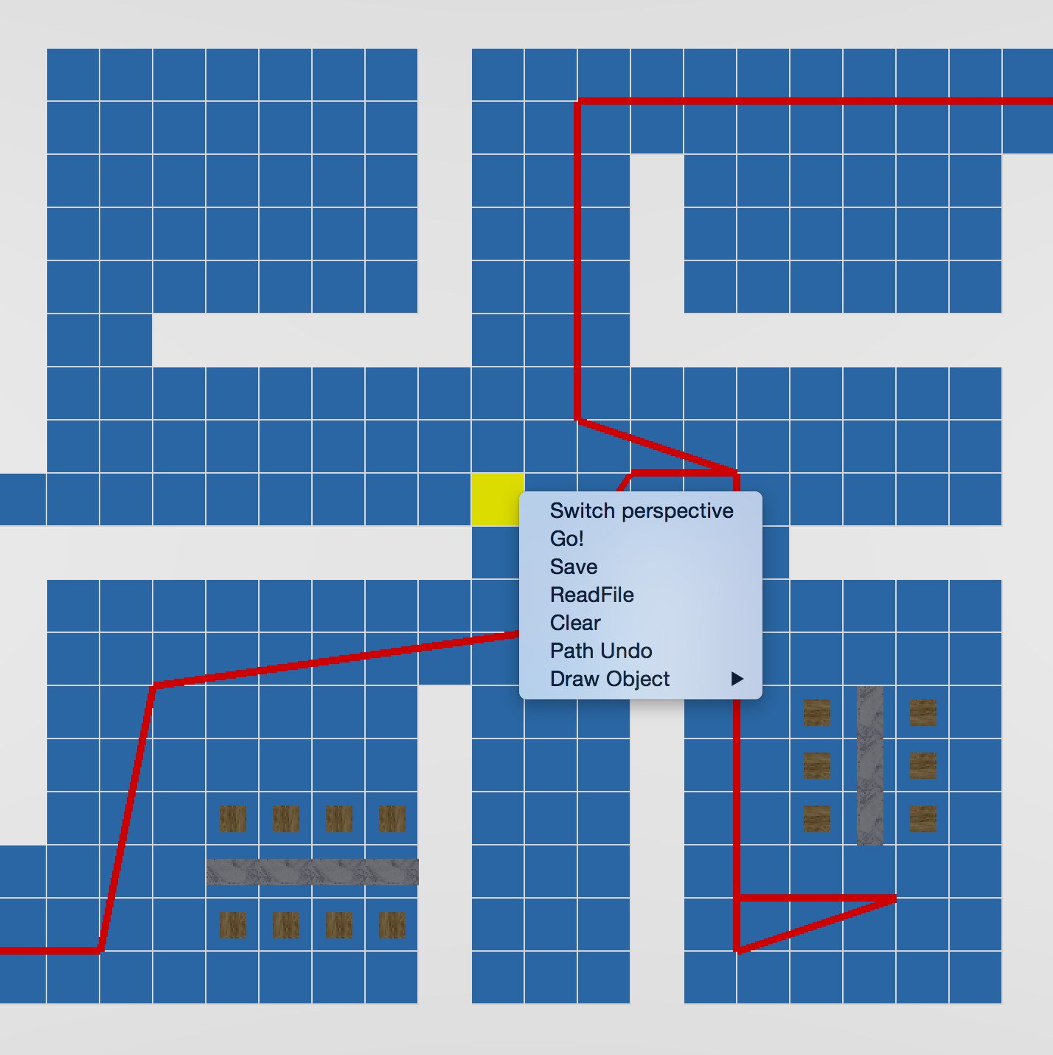
Functions 4 : Additional Utility

Slide 8
Thank you!!

